Slide 1
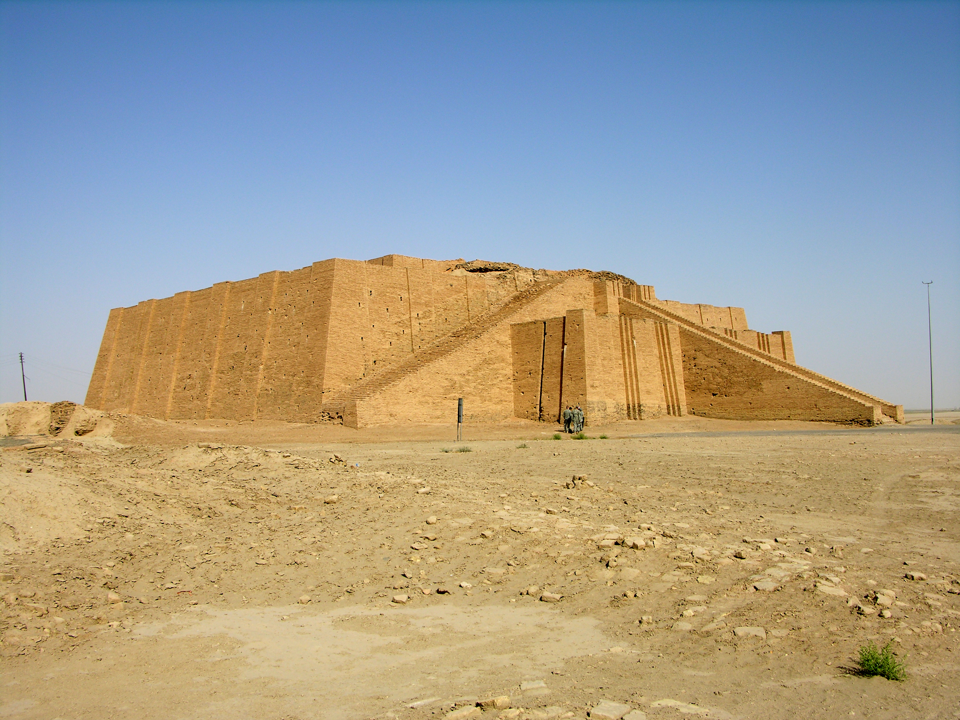
Visit Iraq
Connecting the World to Iraq's Rich Heritage
A comprehensive platform for authentic travel experiences
[1]

Slide 2









The Problem
Market pain points for travellers and hosts
Travellers
Hosts
Fragmented info & limited options
Limited visibility to travellers
Trust & safety concerns
Outdated local platforms
Language barriers
High marketing costs
Cultural misunderstandings
Language & communication gaps
No dedicated marketplace
[2]

Slide 3




Our Solution
A modern, comprehensive tourism directory
Multi‑category listings (accommodations, tours, events)
Admin‑verified quality control
Multi‑language support (English, Arabic, Kurdish)
Trust & safety: verified hosts & secure platform
Heritage‑focused experiences & curated content
Mobile‑first, responsive design
Distinct user roles: travellers, hosts, admin
[3]

Slide 4
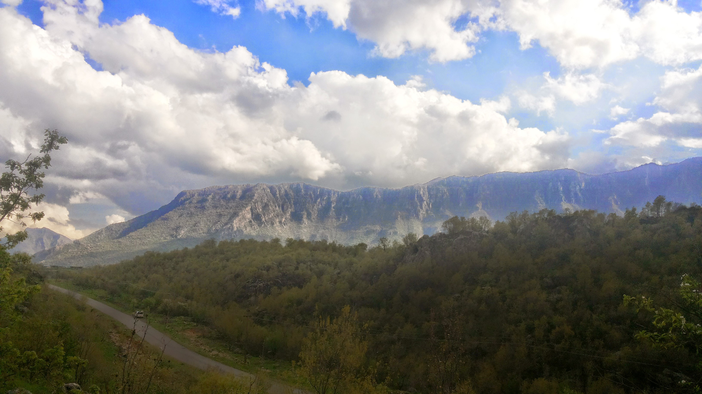
Market Opportunity
Target Segments • Iraqi diaspora (5M+) • Adventure travellers (17% CAGR) • Cultural enthusiasts • Religious pilgrims (20M+ annually) • Business travellers
[4] [5]

Slide 5


Product Demo & User Journey
Stay
Explore
Connect
Find hotels & guesthouses
Discover tours & attractions
Book events & experiences
User Journey • Discover: Search & browse verified listings • Book: Connect with hosts & reserve experiences • Experience: Travel, review & share stories
[6]

Slide 6
Business Model & Revenue
Revenue Streams • Premium listings ($29–99/month per host) • Commissions on bookings (10–15%) • Advertising & sponsored placements • White‑label & affiliate partnerships
Unit Economics • ARPH: $50–150 per host/month • CAC: $20–50 per host • LTV: $600–1,800 • LTV:CAC ratio: 12–36×
[7]

Slide 7
Traction & Roadmap
Current Status • MVP launched & features complete • Marketing strategy developed • Ready to launch pending funding
MVP Ready Platform built, core features complete
Launch (0–3m) 100+ listings, 1K users, marketing launch
Growth (3–6m) 300+ listings, 5K users, 20K visits, 50+ reviews
Scale (6–12m) 500+ listings, 15K users, 50K visits, break‑even
[8] [9]

Slide 8

Go‑to‑Market & Growth Plan
Marketing Phases Pre‑Launch (1–2m): Content, social & community building Launch (3rd m): PR, paid ads, influencer partnerships Growth (4–12m): Scale ads, SEO, email, partnerships Growth Targets 3m: 100+ listings, 1K users, 5K visits 6m: 300+ listings, 5K users, 20K visits 12m: 500+ listings, 15K users, 50K visits
[10]

Slide 9
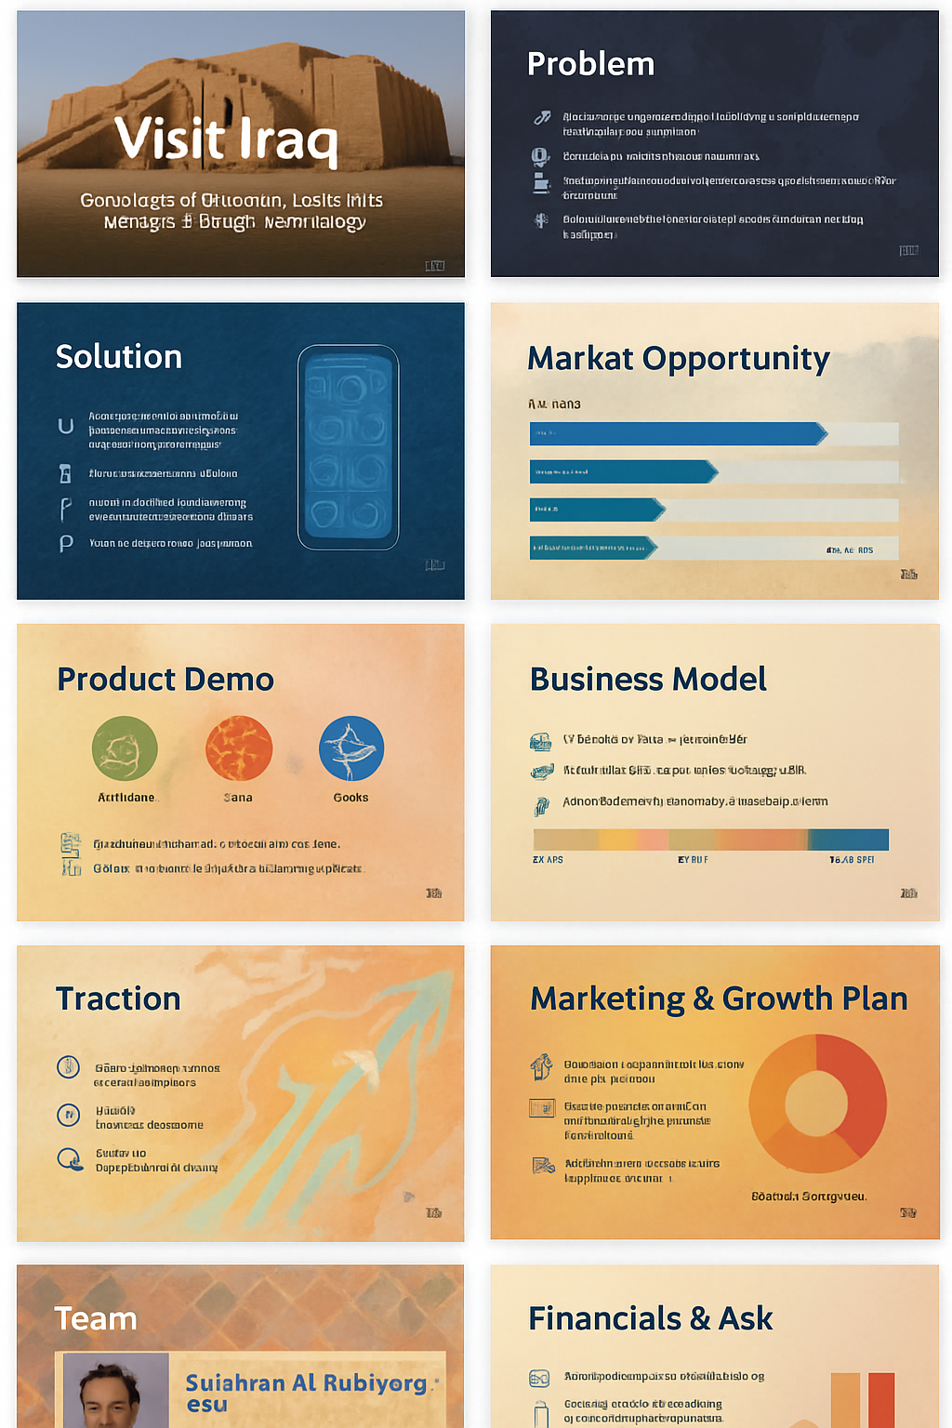


Our Team & Advisors
Founder & CEO Technical & business leader with a deep passion for Iraq’s heritage and tourism. Experienced in software development, product management and startup operations.
Advisory & Investor Value • Strategic guidance in tourism & tech • Network access & partnerships • Marketing & branding expertise
Future Hiring • Content creator & storyteller • Social media manager • Partnership & business development • Customer success & support
[11]

Slide 10
Financials & Funding Ask
Funding Request $75K–100K seed round for marketing, PR, tools, operations & team Investment Highlights • Break‑even in 10–12 months • Multiple revenue streams & high LTV:CAC • 15–25% equity available (negotiable) • First‑mover advantage & regional expansion opportunity
[12] [13]

